Slide 1
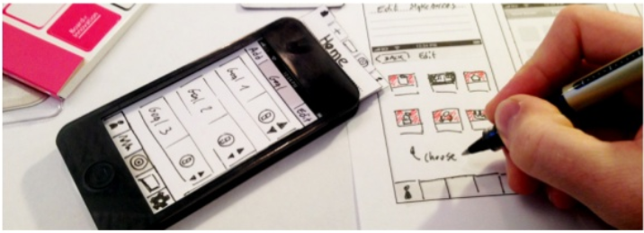
Paper Prototyping
Amir Dirin

Slide 2
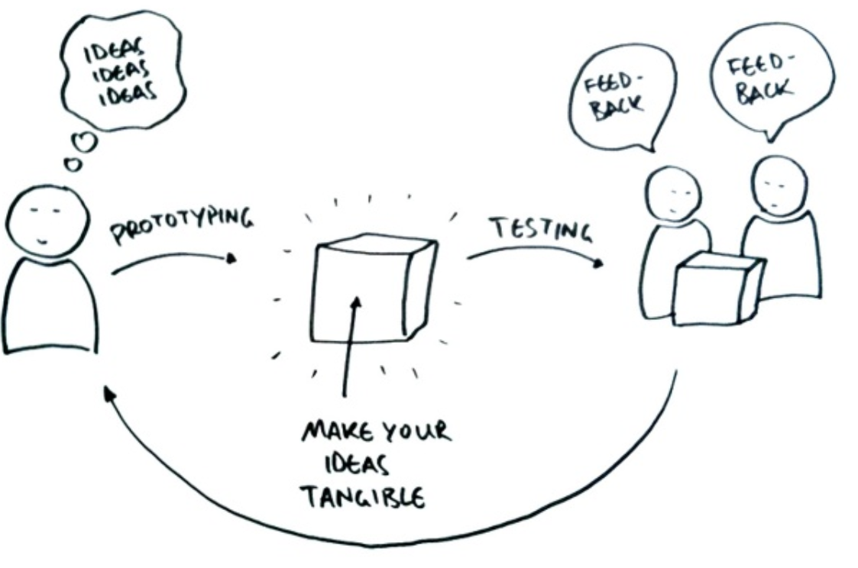
How scenarios are used
Create during design process, keep throughout
Help balance design decisions
Typical projects may have 5 to 500 scenarios

Slide 3
Prototyping Defined
Prototyping is the process of quickly putting together a working model (a prototype) in order to test various aspects of a design, illustrate ideas or features and gather early user feedback.- Wikipedia
IEEE defines prototyping as “ A type of development in which emphasis is placed on developing prototypes early in the development process to permit early feedback and analysis in support of the development process.”

Slide 4
Need for prototyping
Enables us to explore the problem space with the stakeholders.
As a requirements artifact to initially envision the system.
As a design artifact that enables us to explore the solution space of your system.
A vehicle for you to communicate the possible UI design(s) of your system.
A potential foundation from which to continue developing the system

Slide 5
Journey of the Prototyping process
Functionality
Evaluate
Goals
Develop

Slide 6
What is a prototype?
Prototype = “working” model
Full-size or to scale
Fully or partially functioning
Limited representation of an idea
Common in almost every field of engineering design
Airplanes, chemical structures, architecture…
In HCI prototypes may be virtual or physical

Slide 7
Risks in Prototyping
Client may believe that system is real.
Unrealistic expectations of the progress
Implementers make poor choice
Justified in prototype but not in real system
Tempting to build real system same way
Prototype is not identical to the real system
Users may interact differently due to different response characteristics
Must interpret prototype experience with care

Slide 8

Do we need prototyping??
Two “points of interest” for companies to adopt prototyping based methodologies are:
Point 1: They allow us to reduce the cost and time-to-market of a system.
Point 2: For companies building critical systems, prototyping would help them perform formal verification when required. These methodologies provide high level of reliability in the system design and implementation.

Slide 9
Prototyping tool
http://www.creativebloq.com/wireframes/top-wireframing-tools-11121302

Slide 10
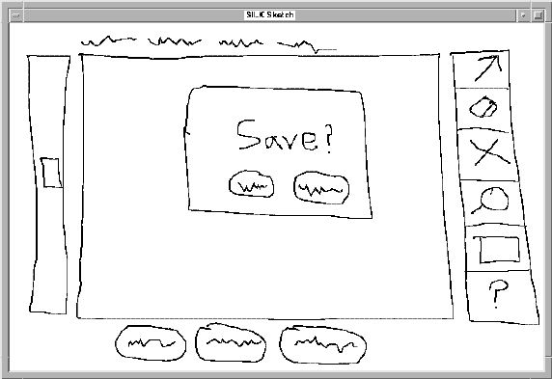
Fidelity in Prototyping
Fidelity refers to the level of detail
High fidelity
prototypes look like the final product
Low fidelity
artists renditions with many details missing

Slide 11
Prototyping: When/How?
Early Design
Brainstorm different representations
Choose a representation
Rough out interface Style
Task centered walkthrough and redesign
Fine tune interface, screen design
Heuristic evaluation and redesign
Usability testing and redesign
Limited field testing
Alpha/Beta tests
Low fidelity paper prototypes
Medium fidelity prototypes
High fidelity prototypes
Working Systems
Late Design

Slide 12
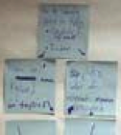
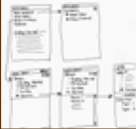
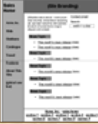

Fidelity
Designers create prototypes at multiple levels of detail, or Fidelity
Example: Web sites are iteratively refined at all levels of detail
Site Maps
Storyboards
Schematics
Mock-ups
Fidelity
High
Low
Notes:
Difference between storyboard - site map: site map on stickynotes which can be rearranged to explore the link structure of this webpage.

Slide 13
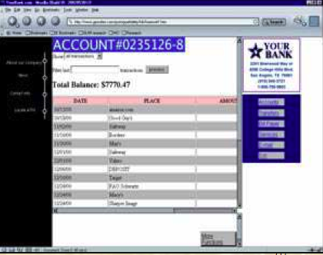
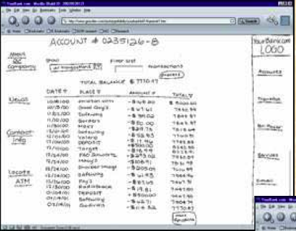
Fidelity Example

Slide 14
Prototype Examples
A series of screen sketches (paper)
A storyboard, cartoon-like series of scenes illustrating key points of a scenario
A PowerPoint Slide show
A video simulating the use of a system
A piece of software with limited functionality written in the target language or in another language
An electronic mock-up (hardware)
A cardboard mock-up
https://www.youtube.com/watch?v=y20E3qBmHpg

Slide 15
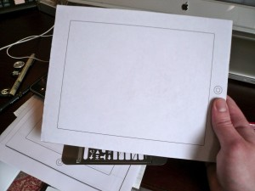
What is this device?

Slide 16
Index Cards
Index cards (3”x5”)… a great size!
Each card represents one screen or one element of a task
Great for software prototypes with multiple screens
Website design
Mobile devices
Windows of software

Slide 17
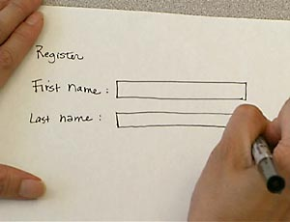
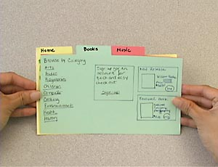
Index Cards (Example)
Include enough detail for users to interact with the prototype
Notes:
I don’t love this example b/c they used some tools to make the prototype look more fancy.

Slide 18
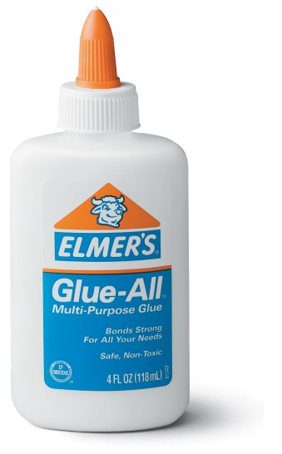
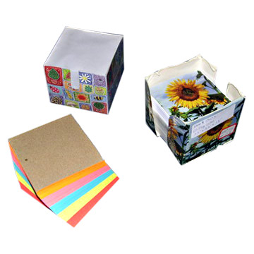

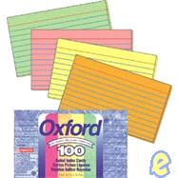
Useful Low Fidelity Tools
Large, heavy, white paper
Index cards
Tape, stick glue, correction tape
Pens & markers (many colors and sizes)
Large sheet of foam core, poster board, butcher paper
Scissors, X-acto knives
Band-aids
Explore your local art store for supplies!

Slide 19
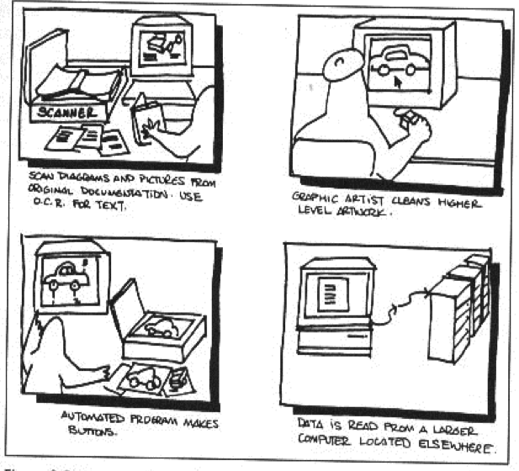
Storyboarding

Slide 20
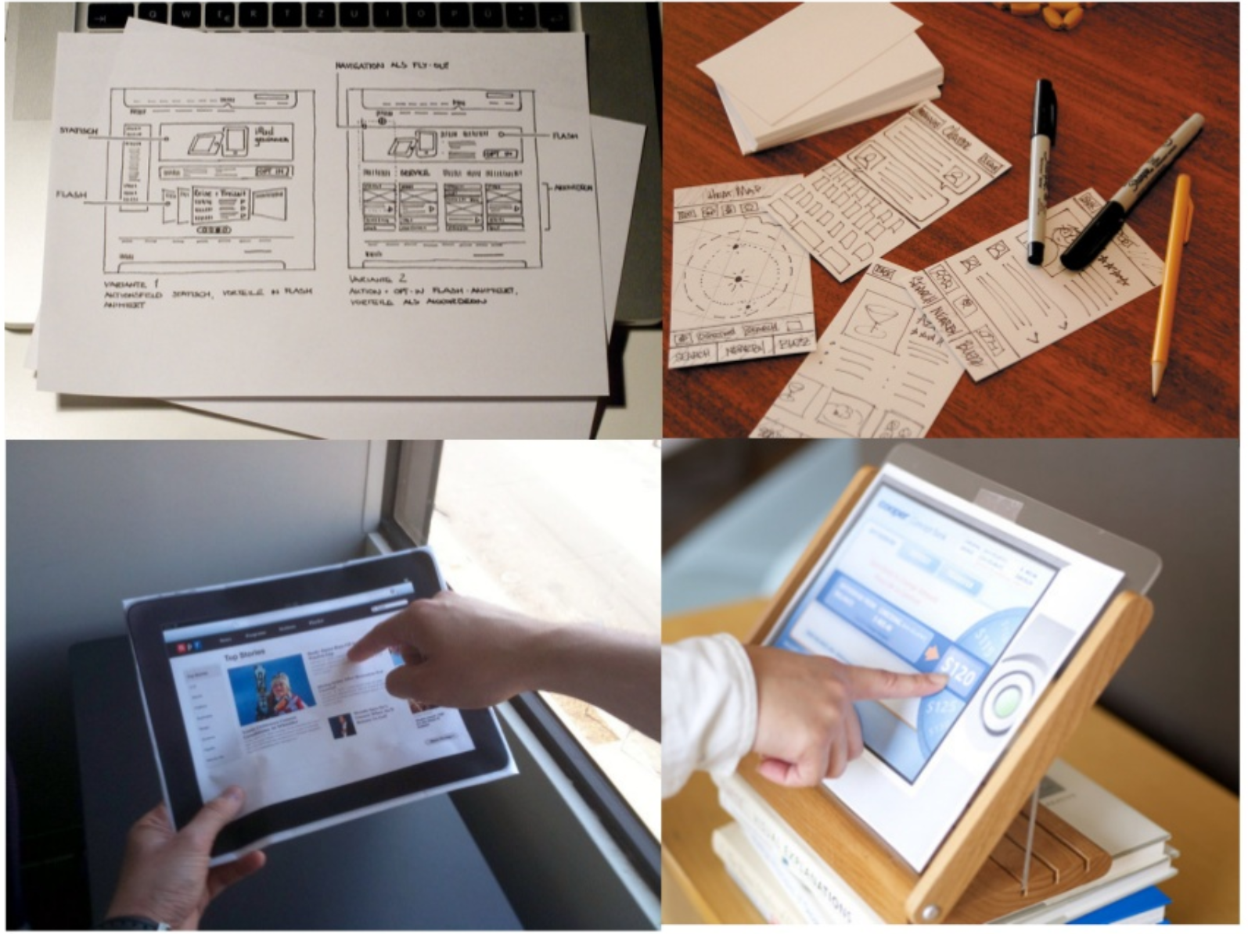
What kinds of interface can create prototype

Slide 21
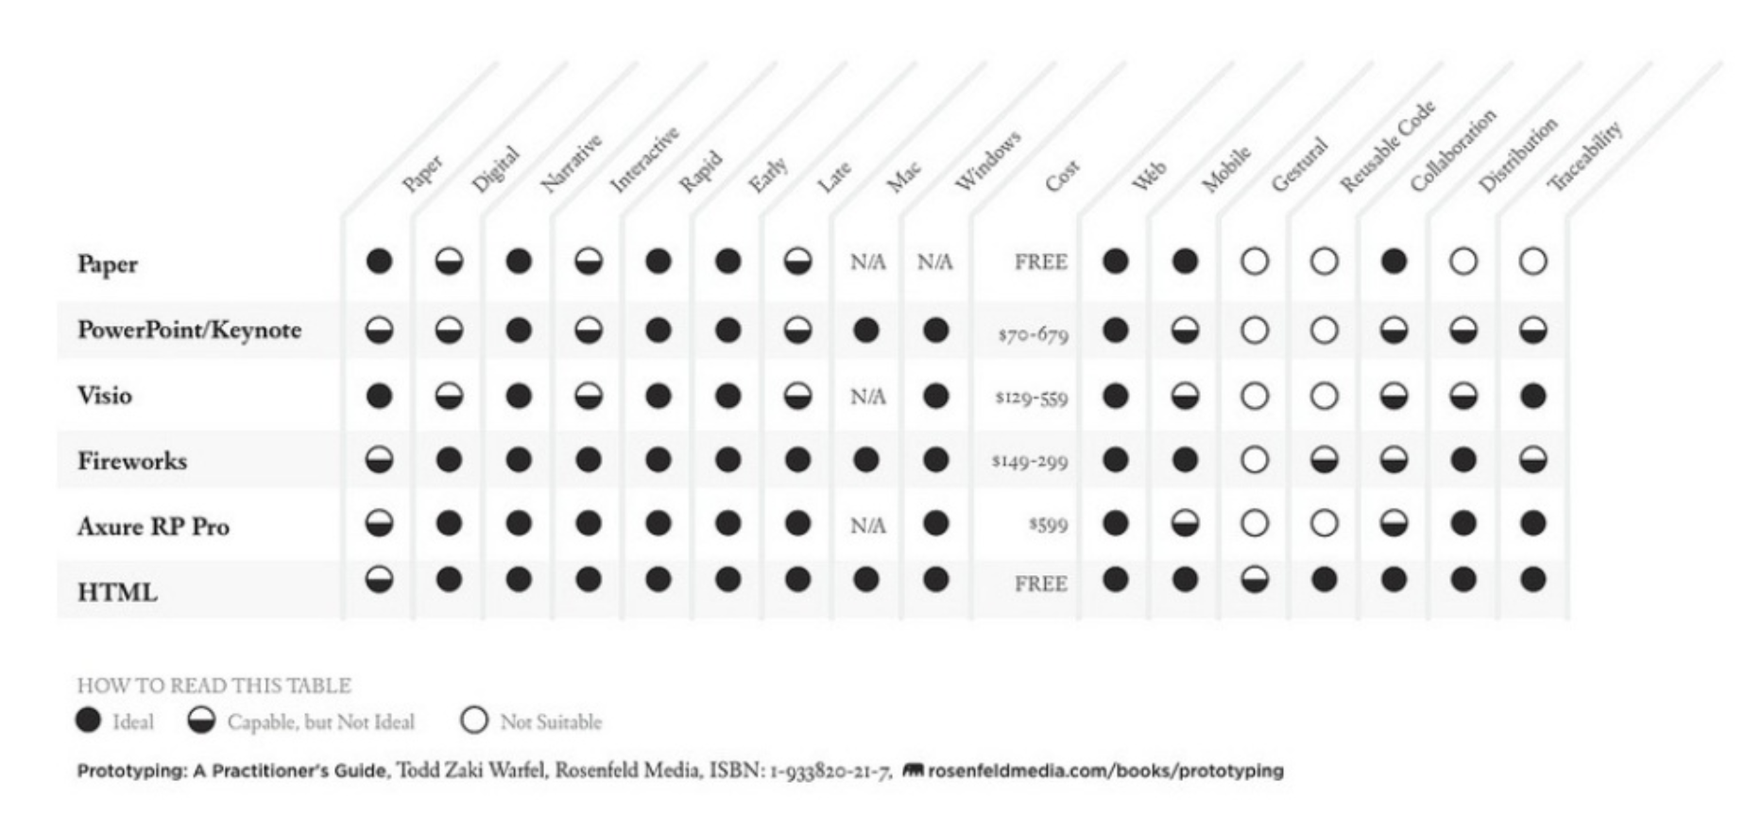
Methods & Tools comparison Matrix

Slide 22
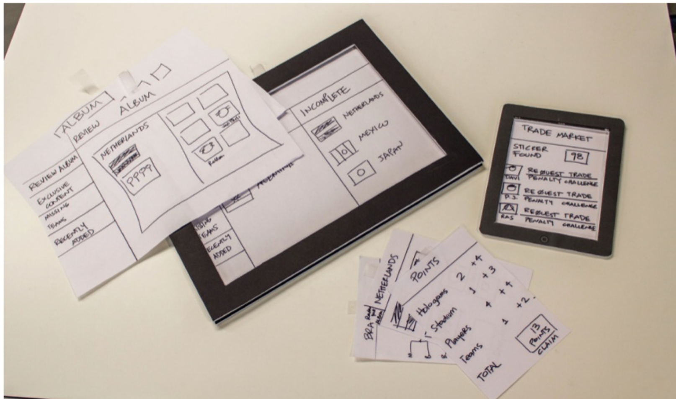
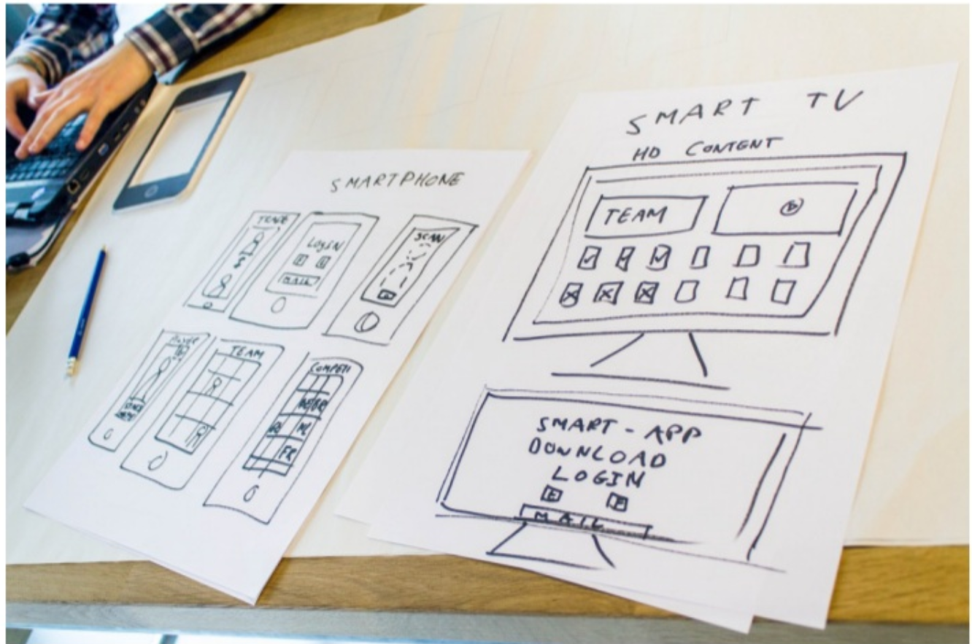
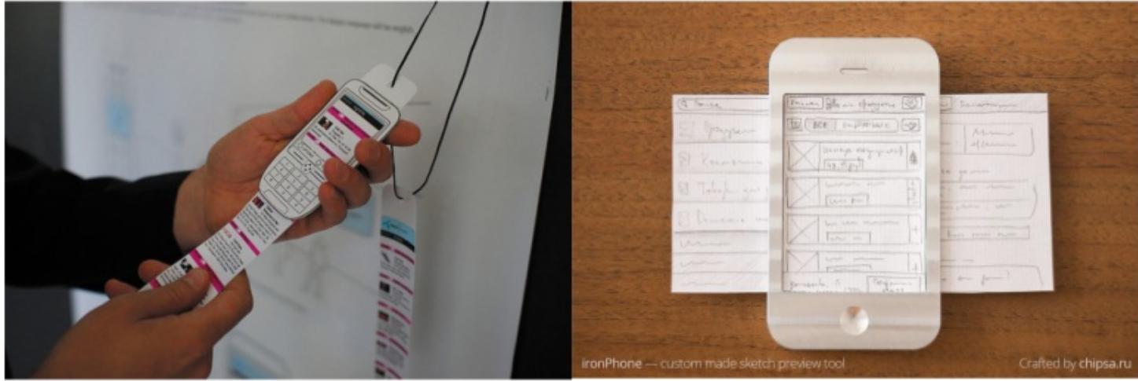
EXAMPLES

Slide 23
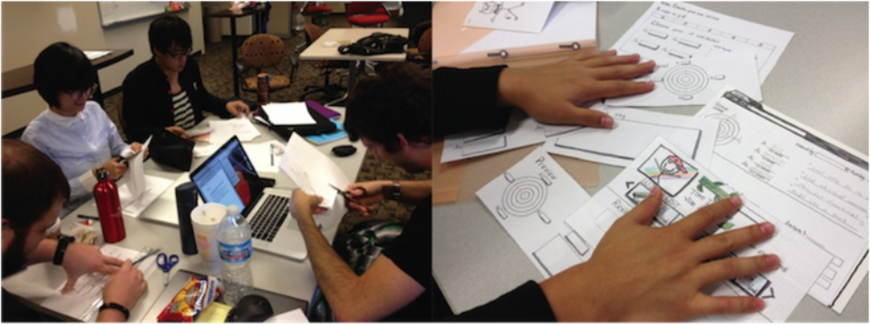
Usability evaluation of paper prototype
Allow user to mock up ideas they think would solve a problem
Mark on the prototype where a user attempted to click or otherwise interact with the interface
Ask users to think aloud what they expect to happen next
Keep going even if you don’t have access to a testing lab or if computers , networks, or high-tech prototypes don’t work as expected

Slide 24
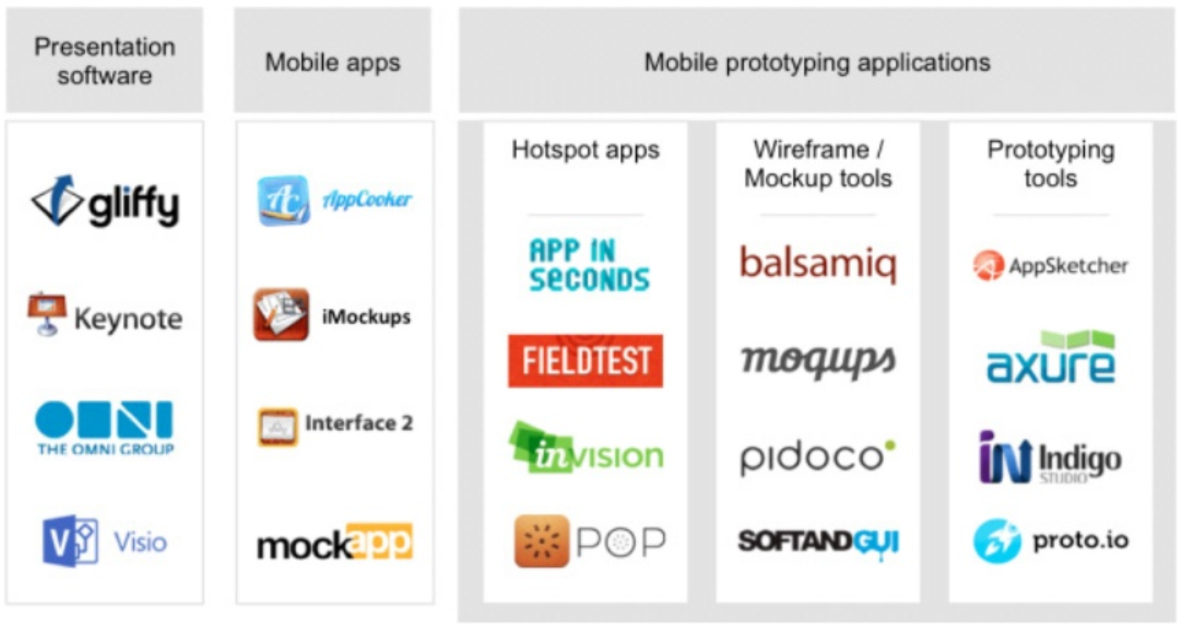
Tools

Slide 25
Prototyping Examples
Pieces of paper
http://www.youtube.com/watch?v=ykJ60H4Qkvg&feature=related
Simulated screen with paper
http://www.youtube.com/watch?v=oITeUEjrY3Q&feature=related
Cell phone testing
http://www.youtube.com/watch?v=Bq1rkVTZLtU&feature=related
Prototype usability testing http://www.youtube.com/watch?v=L7oPR2aTGlM&feature=related
Complete prototyping process
http://www.youtube.com/watch?v=5Ch3VsautWQ
Kid’s game design (what not to do)http://www.youtube.com/watch?v=L3yl9vaJuFE&feature=related

Slide 26
Group Assignment for the week
1. Create a paper prototype of your refined scenario. Note, use different paper for each screen.
2. Start to prepare the final report (See the template in Moodle)

